Slide 1
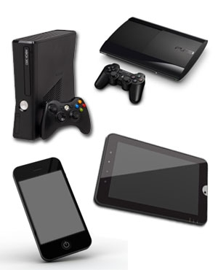
CONSOLE GAMING VS MOBILE GAMING

